Slide 1
Digital Portfolio
STUDENT NAME: Yuvanesh.A
REGISTER NO AND NMID: 20324u09107
A0E867165DA2BE09E944DB8853486D92
DEPARTMENT: BCA
COLLEGE: Dr.M.G.R. CHOCKALINGAM ARTS COLLEGE
UNIVERSITY: THIRUVALLUVAR UNIVERSITY

Slide 2
PROJECT TITLE
Personal Portfolio Website

Slide 3

AGENDA
Problem Statement
Project Overview
End Users
Tools and Technologies
Portfolio design and Layout
Features and Functionality
Results and Screenshots
Conclusion
Github Link

Slide 4
PROBLEM STATEMENT
In today's digital age, students must be equipped not only with academic knowledge but also with the ability to present and showcase their work effectively using digital tools. Traditional methods of maintaining records such as paper-based portfolios are outdated, less interactive, and harder to share or preserve.
A Digital Portfolio provides an interactive, organized, and dynamic platform for students to showcase their skills, achievements, projects, and progress over time. It allows them to:
Demonstrate creativity and individuality.
Reflect on learning experiences.
Share work with peers, educators, and potential employers.
Receive feedback and make improvements.

Slide 5
PROJECT OVERVIEW
In an increasingly digital world, the ability to effectively present personal and academic work online has become essential. The Digital Portfolio project focuses on creating a personalized web-based platform for students to display their skills, achievements, and progress in a creative and organized manner.
This project allows students to:
Develop a responsive and visually appealing portfolio website.
Showcase academic work, personal projects, certifications, and extracurricular activities.
Incorporate multimedia elements such as images, videos, links, and documents.
Gain hands-on experience with web development tools and design principles.
Improve digital literacy, self-reflection, and presentation skills.

Slide 6
WHO ARE THE END USERS?
The end users of the Digital Portfolio are individuals or groups who will interact with, benefit from, or evaluate the portfolio. These include:
Students (Primary Users)
Use the portfolio to showcase academic work, projects, certifications, and personal growth.
Enhance their digital skills and self-presentation abilities.
Use it as a tool for college applications, internships, or job opportunities.
Teachers and Educators
Review and assess students’ progress and creativity.
Provide feedback and track learning outcomes.
Use portfolios as part of performance evaluation or project-based learning.

Slide 7
TOOLS AND TECHNIQUES
To successfully design and build a Digital Portfolio, a variety of tools and techniques can be utilized. These include:

Slide 8
PORTFOLIO DESIGN AND LAYOUT
An effective digital portfolio should be both visually appealing and easy to navigate, ensuring that users can quickly find and understand the showcased content. Below is a recommended structure and layout:
8

Slide 9
FEATURES AND FUNCTIONALITY
A well-designed Digital Portfolio should offer interactive and user-friendly features that enhance both the presentation of content and the user experience. Below are the key features and functionalities:

Slide 10
RESULTS AND SCREENSHOTS
The final output of the Digital Portfolio project reflects the application of web design principles, creativity, and technical skills. This section highlights what has been achieved and showcases visuals to demonstrate the portfolio in action.
10

Slide 11
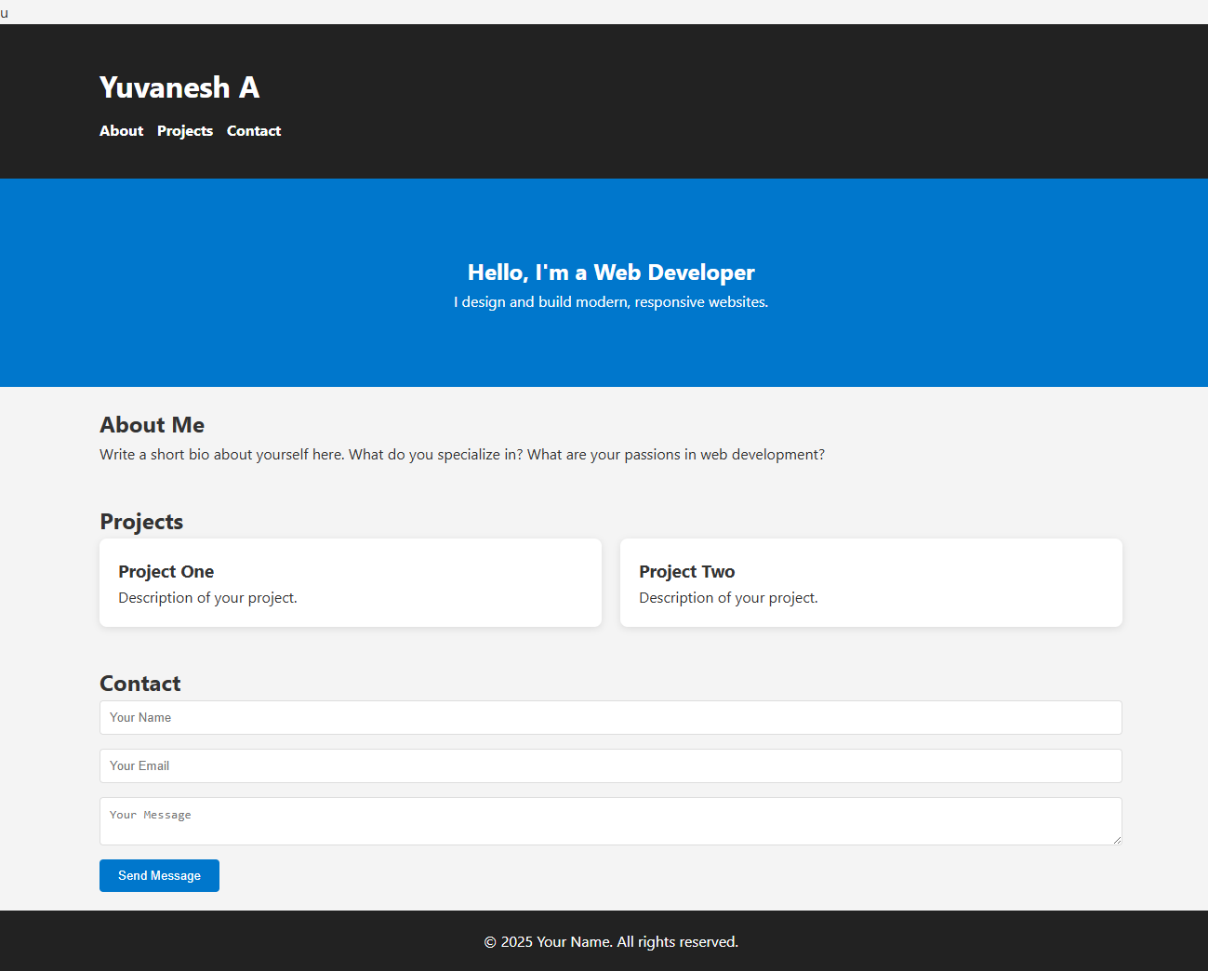
SCREENSHOT/ OUTPUT

Slide 12
CONCLUSION
The Digital Portfolio project has provided a valuable opportunity to integrate creativity, technical skills, and self-expression into a unified digital space. Through the design and development of the portfolio, students have gained:
Practical experience in web design and digital tools.
The ability to organize and present their achievements effectively.
A deeper understanding of personal strengths, growth, and goals.
A professional platform that can support future academic or career pursuits.
In a world where digital presence is increasingly important, this portfolio not only serves as a record of learning but also as a personal brand showcase. The project encourages continuous improvement and reflection, laying the foundation for lifelong digital competency.
12

Slide 13
PROJECT LINK
https://github.com/yuvanesha20324u09107-crypto/digital-portfolio.git
OUTPUT LINK
https://yuvanesha20324u09107-crypto.github.io/digital-portfolio/

